Slide 1
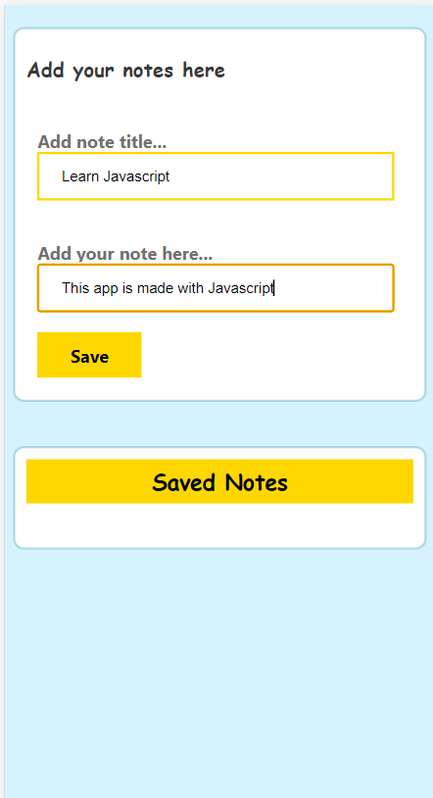
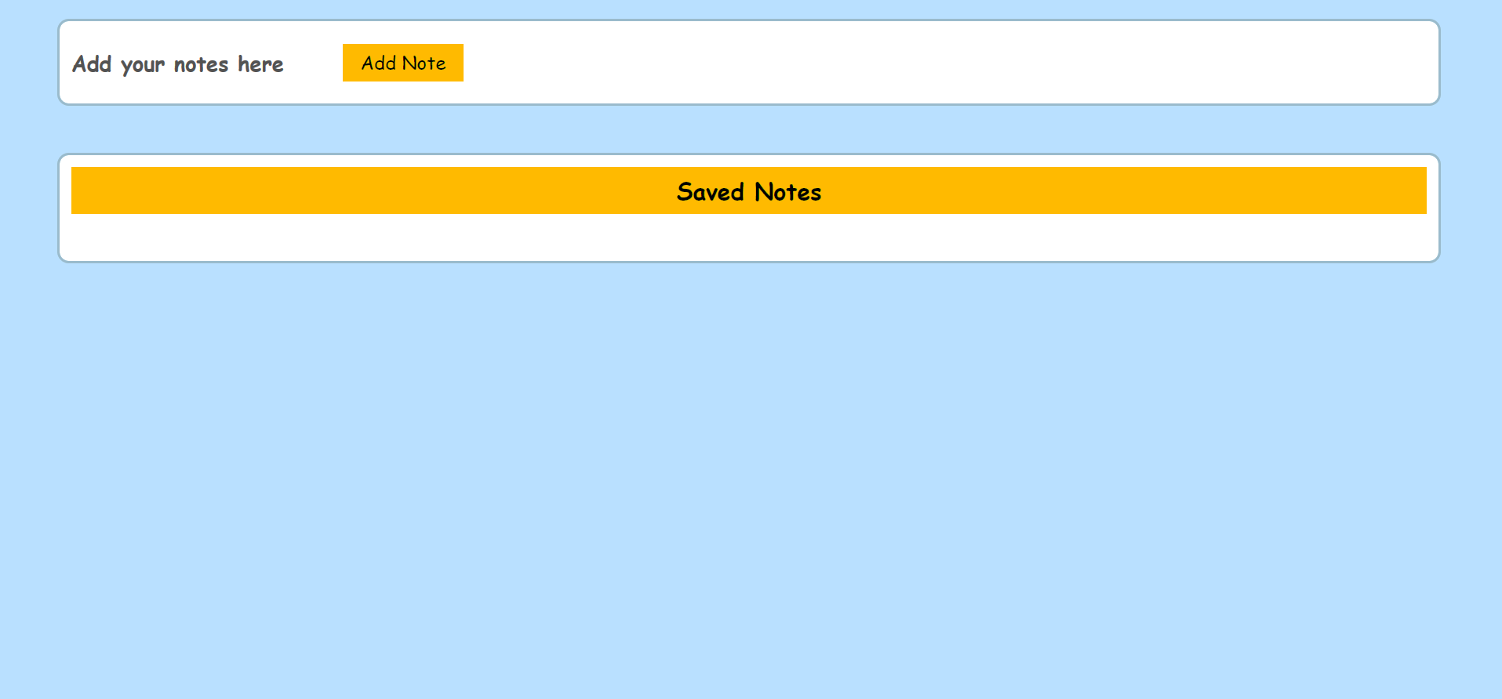
notes App in javascript
This simple web app note is made using html/css/javascript and is also responsive.

Slide 2
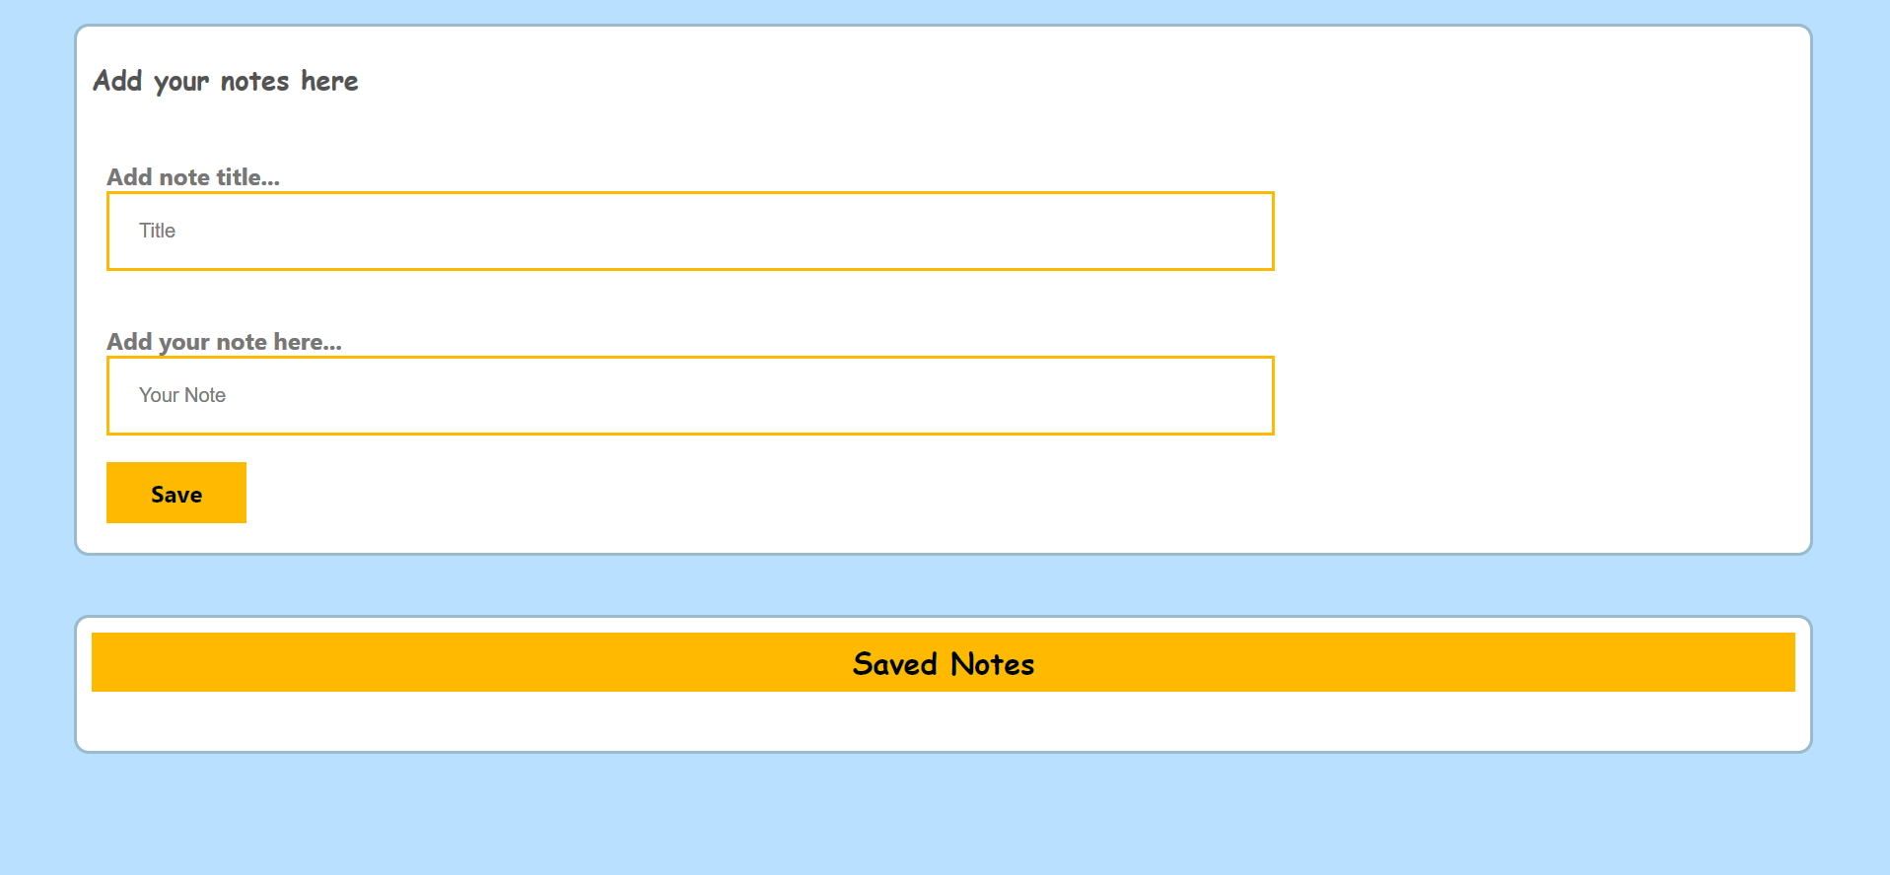
To save a Note, firstly you have to fill the title and to add you note than click ‘Save’.

Slide 3
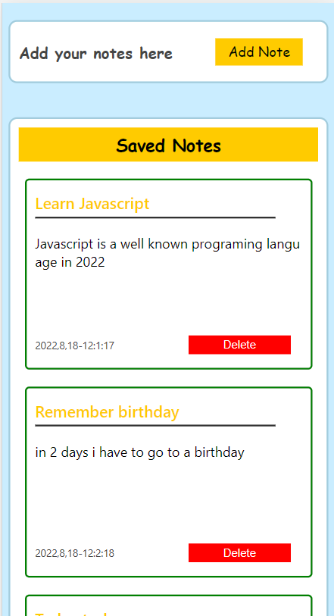
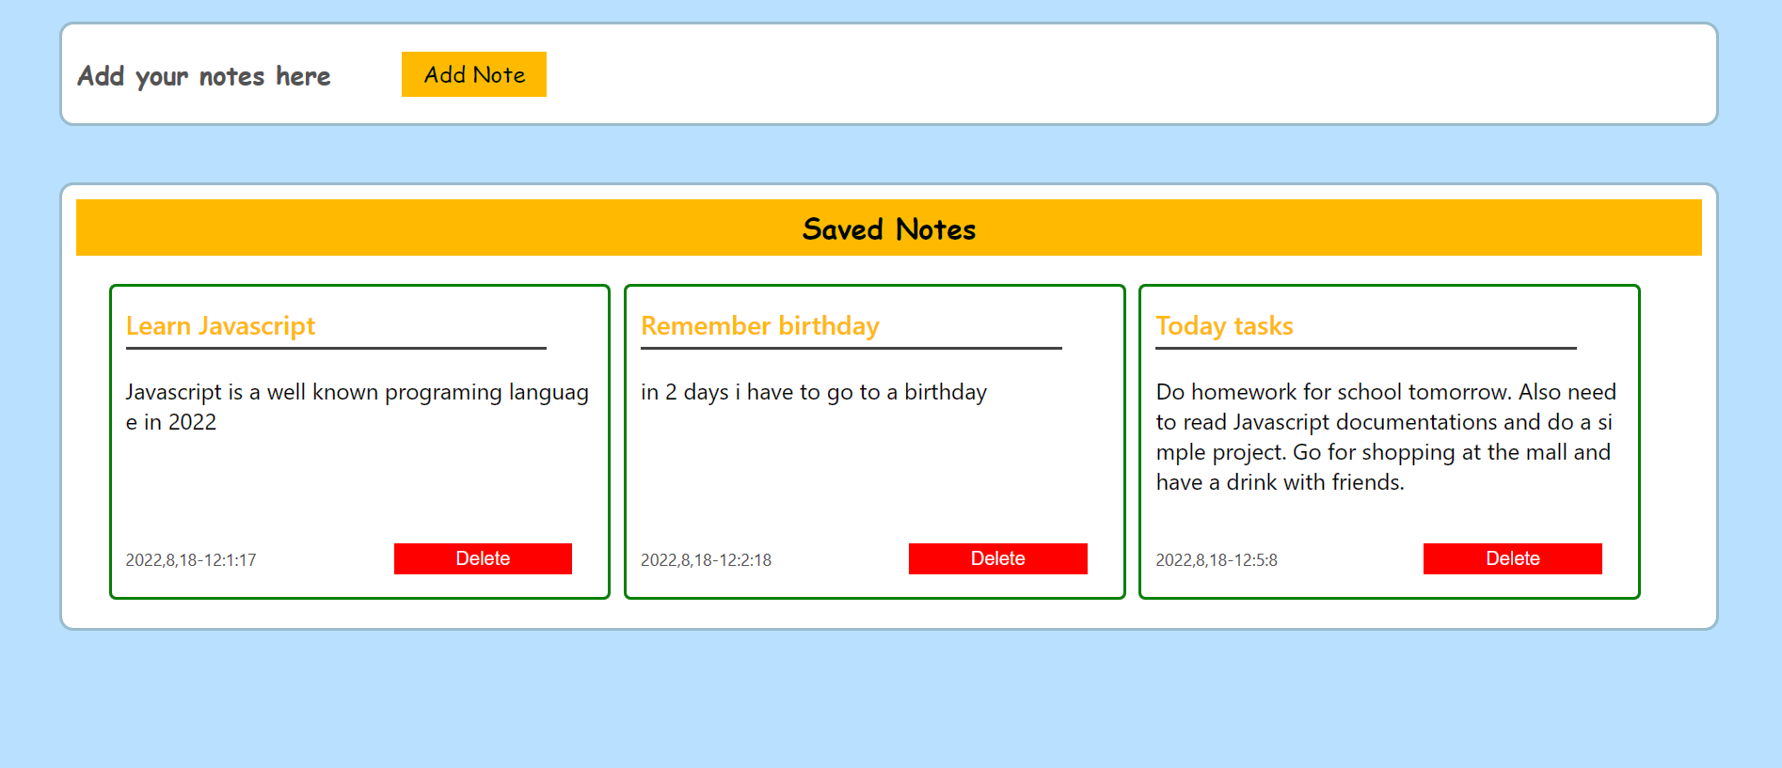

Slide 4
Thank You
@armendtahiraj

